Slide 1
Welcome!
Illinois Knights of Columbus
Joliet Diocese
Safe Environments – Questions, Answers, and Assistance!

Slide 3
Council Requirements for a Safe Environment :
Email addresses are mandatory to appoint members into ALL roles that have safe environment requirements.
Emails must be unique to the member, CANNOT be gkcouncil123@XYZ.com to ensure that members retain credit for completing their training and background checks

Slide 4
Council Requirements for a Safe Environment :
Grand Knight, Program, Community, and Family Directors must complete Safe Environment training.
The Community Director and the Family Director must also provide consent for a background screening (criminal and motor vehicle records).

Slide 5
Council Requirements for a Safe Environment :
There must be a Grand Knight assigned via Form 185 with a unique email address.
Video how to submit online: https://players.brightcove.net/802593642001/y6FLiIa0f_default/index.html?videoId=6191938577001

Slide 6
Council Requirements for a Safe Environment :
The council must have submitted Form 365 naming Program, Community, and Family Directors.
Video how to submit online: https://players.brightcove.net/802593642001/y6FLiIa0f_default/index.html?videoId=6191938577001

Slide 7
Council Requirements for a Safe Environment :
When you submit the 365 Report, there must be three different members assigned to:
Program Director
Community Director
Family Director
*Grand Knights may only hold one of the additional director roles listed above

Slide 8
Safe Environment Council Compliance Guide
All council compliance information can be found in the below guide on KofC.org
www.kofc.org/en/resources/safe-environment-program/state-leader-compliance-guide.pdf

Slide 9
Fast Track - Safe Environment Compliance
Submit Form 185 – reports Grand Knight, Grand Knights needs to be committed to take the training.
Submit Form 365 – reports Program, Community, and Family Directors who are committed to take the training.
Call (203) 800-4940 - Explain the training is needed ASAP.
After Training Call (203) 800-4940 - Inform them, the training is completed, and they can update the system ASAP.

Slide 13
After logging into the Praesidium Academy you will come to this welcome screen.

Slide 14
From your welcome screen, if you scroll down, you will find your “Start Here” section. Click on “Start Learning Path” to begin your training.

Slide 15
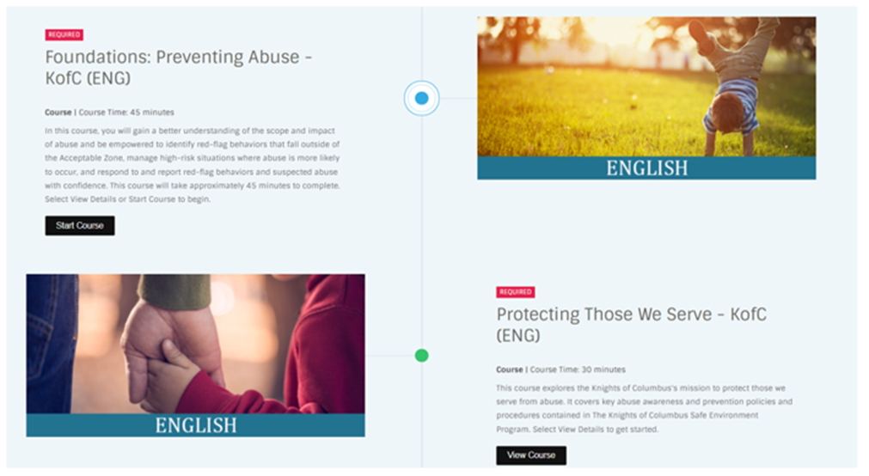
There are two courses you must complete to be Safe Environment compliant. “Foundations: Preventing Abuse – KofC” and “Protecting Those We Serve – KofC”. Total time to complete both courses is approximately 1.5 hours.
NOTE: Your Diocese may require you to take Protecting Gods Children Training. Please confirm with your Pastor on your Parish requirements.

Slide 16
The information in the red box shows how many courses are taken / required.
The information in the red circle indicates the next course to complete.

Slide 17
Once you have completed your required courses, your learning path will update and show the following: Red Square – Certificate Granted Red Circle – 2 / 2 (taken / required) content

Slide 18
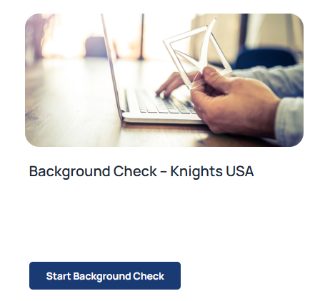
Community and Family Directors will be required to submit for a Background Check. This option will become available to once a Knight has completed both courses. If the Background Check is not completed, a Knight will show as “Pending” or “Non-Compliant” until it is completed.

Slide 19
Safe Compliant Knights will have to renew their certification every 3 years. They will receive an email from Praesidium when their 30-day window starts to re-train.

Slide 20
Access Praesidium Academy
Technical Support:
877.777.0070
Knights of Columbus
Office of Safe Environments
Office of youth protection
Phone: (203) 752-4558
email: oyp@kofc.org

